Slide 1
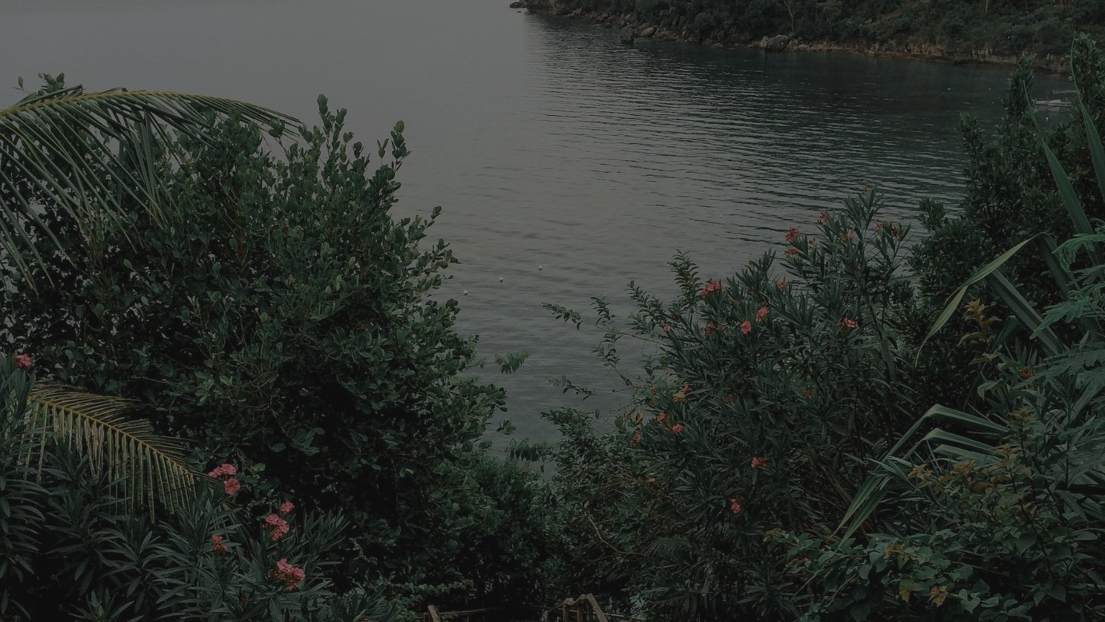
🍂
The impact of urban greenery level on Indigenous mental health.
Image: Jhosie Espantaleon

Slide 2
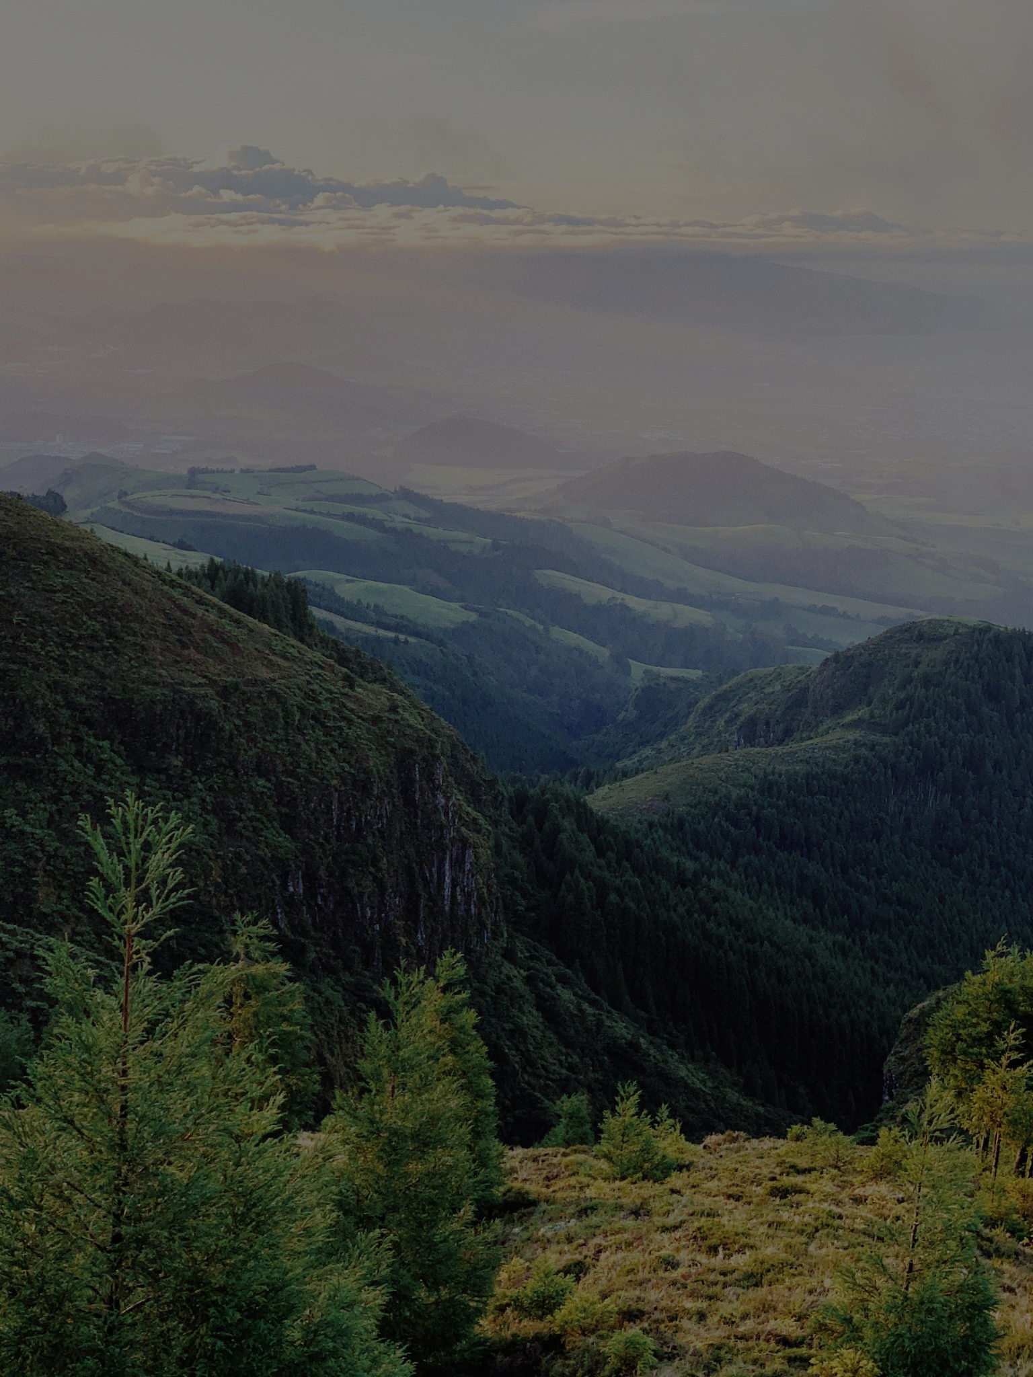
Introduction
⛓️ Correlate Greenery, Indigenous identity and Mental health
🌲 Nature is key to the Indigenous [1]
⚖️ Unequal greenery distribution [2]
🏙 Aid urban development
🍂 Strengthen Indigenous research
Image: Sergei Wing

Slide 3

Methods
⏰ Cross sectional study of 2018
🌲 Greenery levels (NDVI)
🧠 Self-perceived mental health
🧪 Chi-square test
- Demography → Mental health (n=134)
- Greenery → Mental health (n=195)
- Interaction Greenery ↔ Demography (n=282)
🚩 250 random samples for countrywide coverage
Image: Tom Barrett

Slide 4

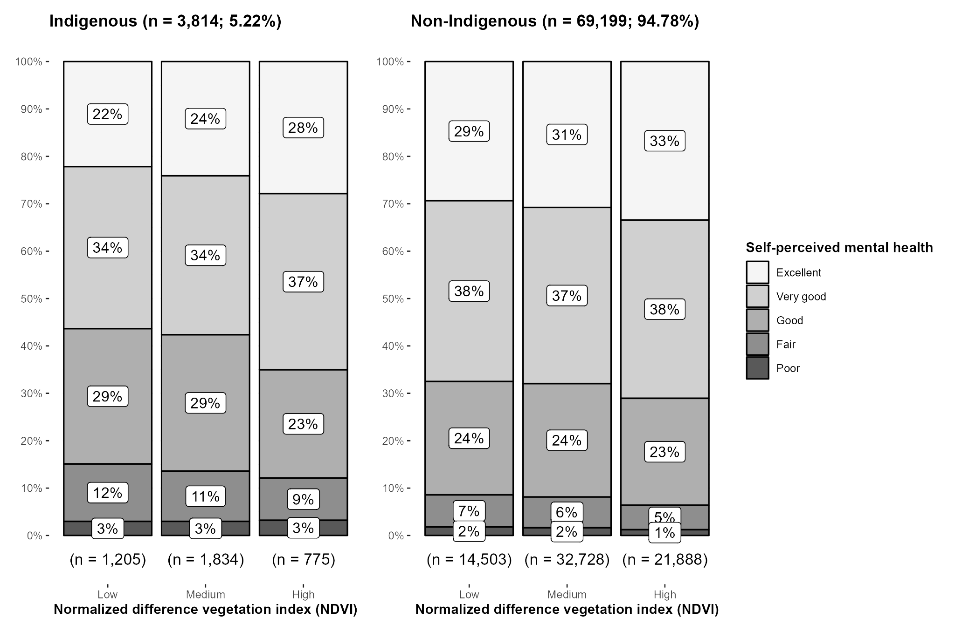
Results
📖 Figure 1:
Dataset overview of
n = 72,933 effective participants categorized by Indigenous identity, greenery levels and self-perceived mental health
Image: Daniel Shapiro

Slide 5
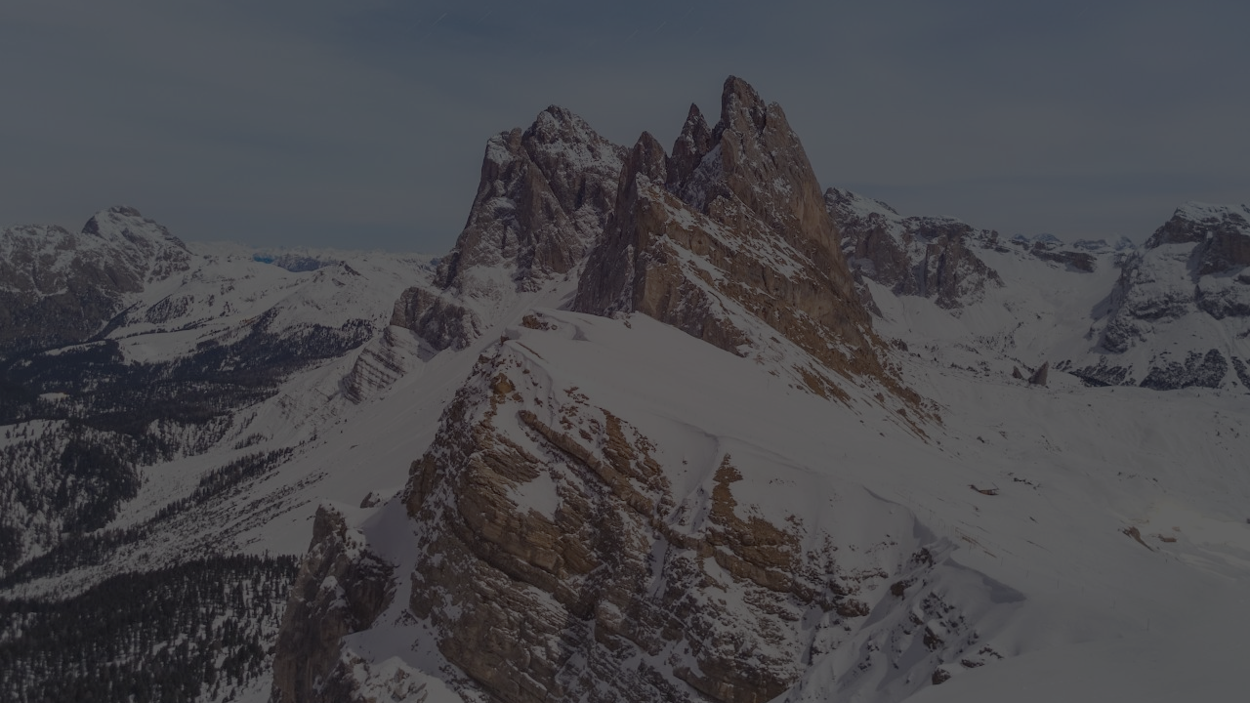
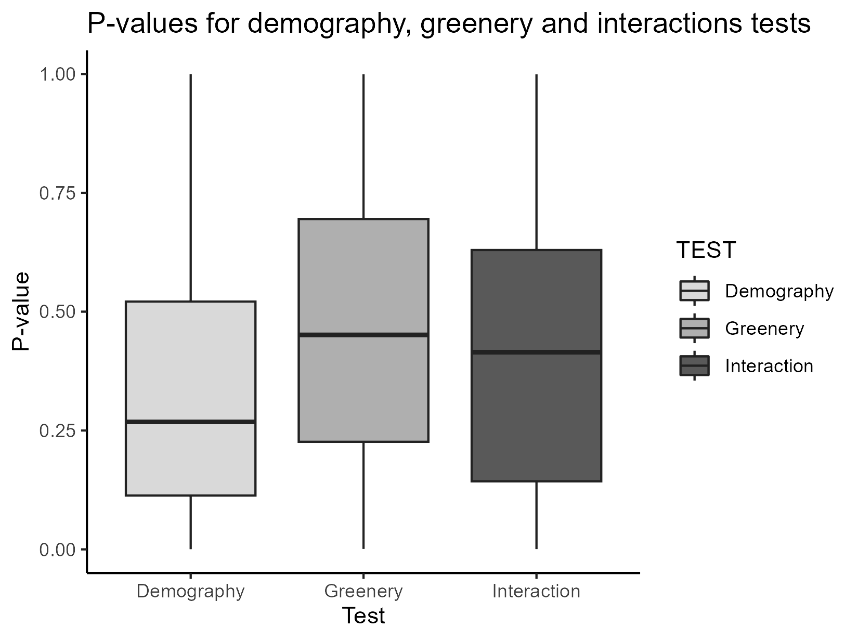
Results
📖 Figure 2:
Insignificant Chi-Square test p-values collected for demography, greenery and their interactions on mental health over 250 random samples
Image: Marek Piwnicki

Slide 6
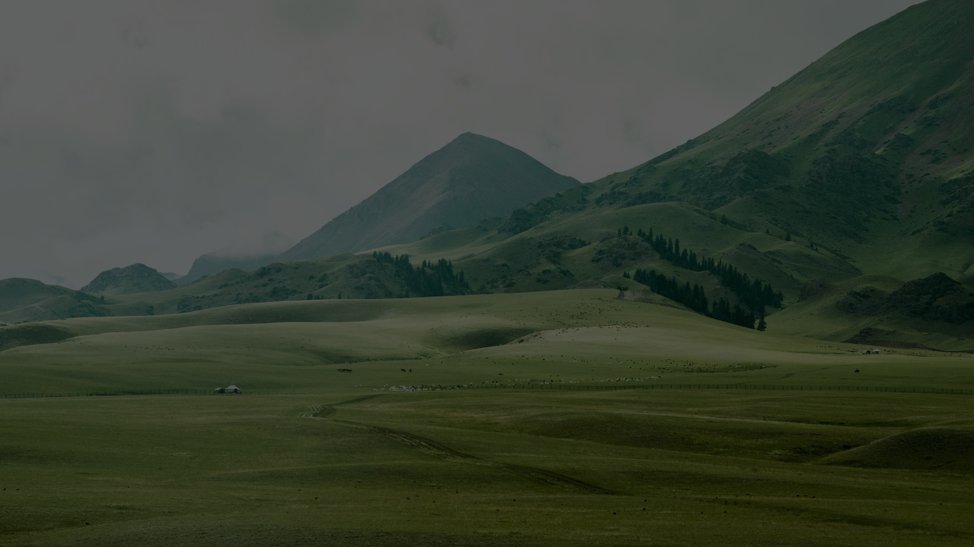
Discussion
📊 Few tests were significant
→ Inconclusive
🌳 Imprecision of greenness
⚖️ Unbalanced data (5.22% Indigenous)
🧠 Self-report biases
💊 Alternatives to improve well-being
📝 More Indigenous research needed
Image: Jeremy Cai

Slide 7
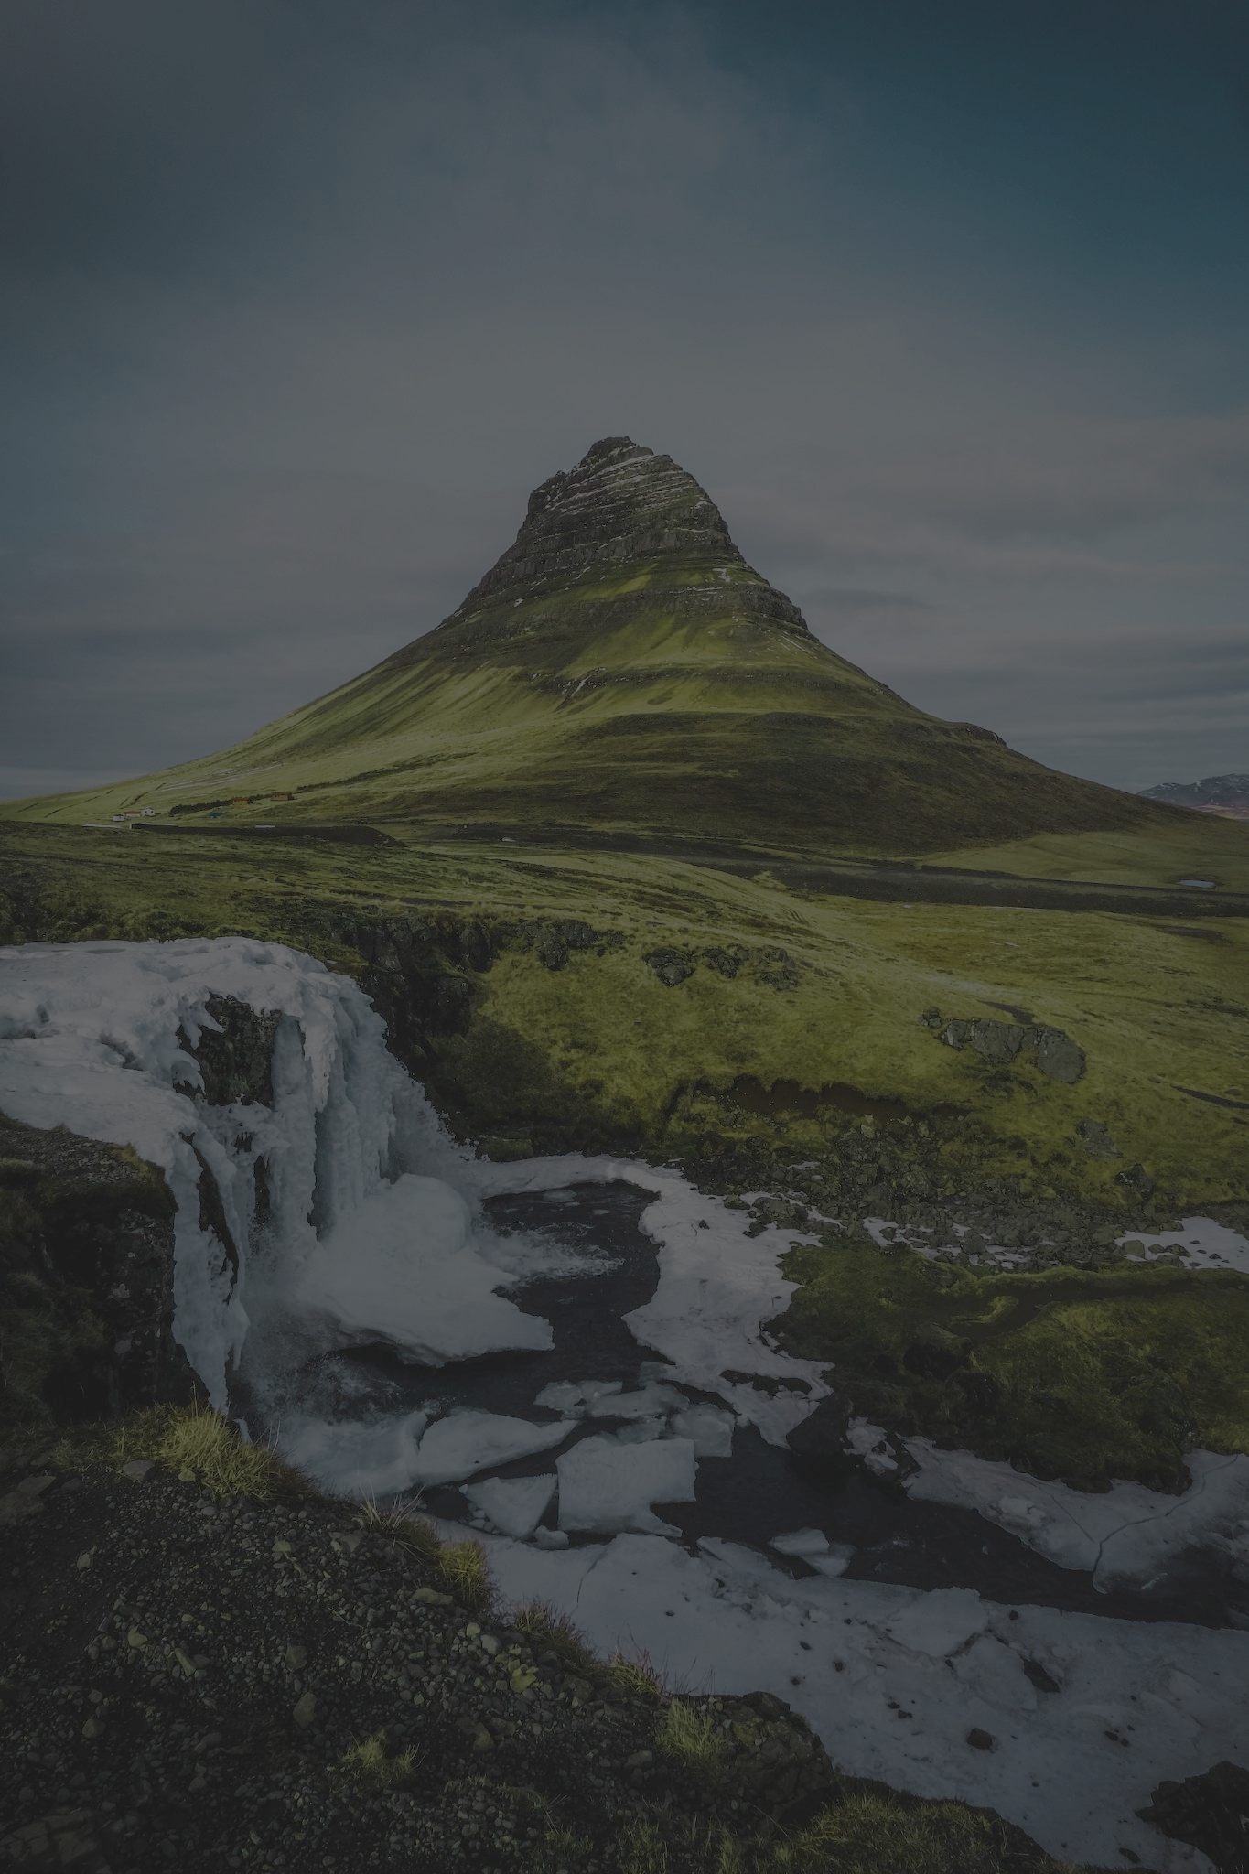

References
Additional visualizations and resources
[1] Government of Canada, S. C. (2021, May 19). Ethnocultural and socioeconomic disparities in exposure to residential greenness within urban Canada. https://www150.statcan.gc.ca/n1/pub/82-003-x/2021005/article/00001-eng.htm
[2] Hatala, A. R., Njeze, C., Morton, D., Pearl, T., & Bird-Naytowhow, K. (2020). Land and nature as sources of health and resilience among Indigenous youth in an urban Canadian context : A photovoice exploration. BMC Public Health, 20(1), 538. https://doi.org/10.1186/s12889-020-08647-z
[3] Barton, J., & Rogerson, M. (2017). The importance of greenspace for mental health. BJPsych International, https://www.ncbi.nlm.nih.gov/pmc/articles/PMC5663018/?report=classic
[4] Logie, C. H., Lys, C. L., Sokolovic, N., Mackay, K. I., Donkers, H., Kanbari, A., Pooyak, S., & Loppie, C. (2021). Contextual factors associated with depression among Northern and Indigenous adolescents in the Northwest Territories, Canada. Global Mental Health (Cambridge, England), 8, e22. https://doi.org/10.1017/gmh.2021.21
Image: Bypaul

